Slide 1




PORTFOLIO
Jessica Pellett
Data Analyst
Resume
Email Me
About Me

Slide 2
Fundamental Coursework
Semester One
System Analysis and Design
Course Overview
Database 1
Intro to Computers and Programming
Microsoft Excel
Assignments

Slide 3
Fundamental Coursework
Semester Two
Course Overview
Programming Fundamentals
Database 2
Business Analytics
BI Data 1
Assignments

Slide 4
Fundamental Coursework
Semester Three
Course Overview
Introduction to ETL
Python
Project Management
BI Data 2
Assignments

Slide 5
Fundamental Coursework
Semester Four
Course Overview
Machine Learning
Data Capstone
Data Security and Privacy
BI Data 3
Assignments

Slide 6





ABOUT ME
Detail is key
I am an energetic and passionate college student working towards a information technology degree, seeking a summer internship at the next big digital company.
Education
2025
Associates in IT - Data Analytics
Chippewa Valley Technical College
GPA of 3.84 / 4.00
Jessica Pellett (she/her)
Data Analyst
Experience
2023
Data Entry
Menards
CONNECT WITH ME
Resume

Slide 7
Semester One Course Work
Intro to Computers & Programming
This course introduces foundational concepts in information technology, software development, and data analytics. Exploring computer hardware and software interactions, classifing programming languages, and analyzing connections between technology and everyday life. Through hands-on experience, developing problem-solving skills, applying fundamental cybersecurity principles, and practicing programming logic using JavaScript and source control techniques.
Database 1
Examine database systems' impact on various industries while learning key relational database theories and structures. This course covers essential database models, SQL query development, and multi-table data retrieval techniques. Gaining practical experience using database management systems to manipulate and analyze information effectively.
Systems Analysis and Design
This course explores the role of systems analysis within the System Development Life Cycle (SDLC) and IT organizations. Investigating business processes, strategic planning, requirements gathering, and various system development methodologies. Topics include database design, system architecture, security measures, and project management strategies for effective IT solutions.
Microsoft Excel
Develop proficiency in Excel, learning how to prepare, format, and manipulate spreadsheets for data analysis and communication. This course covers advanced formulas, functions, charts, and graphical representations to enhance data visualization and interpretation. Integrating Excel with email and scheduling tools for efficient workflow management.

Slide 8



Database 1
Overview
This course explores relational database concepts, SQL queries, and data management techniques. Students will learn how to design databases, retrieve and manipulate data, and optimize database efficiency.
Key Skills & Knowledge Gained:
Writing SQL queries for data retrieval and manipulation
Developing ERDs (Entity-Relationship Diagrams) for structured data modeling
Understanding relational database structures, normalization, and keys
Utilizing database management systems for real-world applications
Content Covered
SQL Queries & Data Retrieval
Basic SELECT Statements: Extracting relevant data
JOINs: Combining multiple tables for complex queries
Subqueries: Filtering and structuring query results
Database Design & ERDs
Normalization: Organizing data efficiently
Keys & Relationships: Using primary and foreign keys effectively
Entity-Relationship Diagrams: Mapping database structures

Slide 9

Systems Analysis and Design
Overview
This course delves into the principles of system development and project management within IT organizations. Students will examine the System Development Life Cycle (SDLC) and methodologies for analyzing, designing, and implementing efficient systems.
Key Skills & Knowledge Gained:
Understanding the SDLC phases: planning, analysis, design, implementation, and support
Conducting SWOT analysis and business case evaluations
Gathering system requirements through interviews, surveys, and documentation
Developing project plans and risk management strategies
Content Covered
System Planning & Analysis
Strategic Planning: Utilizing SWOT analysis for business development
Requirements Gathering: Effective techniques for understanding user needs
System Design & Implementation
User Interface Development: Designing intuitive applications
Database & Network Architecture: Structuring efficient IT systems

Slide 10

Intro to Computers & Programming
Overview
This course introduces students to fundamental concepts in information technology, software development, and data analytics. It explores computer components, operating systems, programming languages, and cybersecurity principles, providing a strong foundation in problem-solving and programming logic.
Key Skills & Knowledge Gained:
Identifying and understanding physical computer components
Navigating operating systems using both GUI and CLI
Exploring software development and programming languages
Applying cybersecurity best practices for secure computing
Solving programming logic problems using operators and comparison
Using JavaScript and source control techniques for coding
Content Covered
Computer Hardware & Software Interactions
Understanding Components: CPU, memory, storage, input/output devices
Software & Data Analytics: Exploring connections between applications and real-world use
Operating System & File Management
Command Line Interface (CLI): Executing fundamental system commands
File System Navigation: Managing files and directories using GUI & CLI
Programming & Problem Solving
Programming Logic & JavaScript: Understanding sequential, decision-based, and iterative program flows
Development Tools: Utilizing flowcharts and pseudocode for problem-solving

Slide 11

Microsoft Excel
Overview
This course provides students with essential spreadsheet skills for data organization, analysis, and visualization using Microsoft Excel.
Key Skills & Knowledge Gained:
Creating and formatting professional spreadsheets
Writing and applying advanced formulas and functions
Visualizing data with charts and graphs
Integrating Excel with email and scheduling tools
Content Covered
Data Manipulation & Formatting
Formulas & Functions: Applying calculations for data processing
Conditional Formatting: Enhancing readability and interpretation
Data Visualization & Analysis
Charts & Graphs: Transforming numerical data into visual insights
Trend Analysis: Identifying patterns in data

Slide 12




System Analysis
Microsoft Excel
and Design
Intro to Computers
Database 1
and Programming

Slide 13
Semester Two Course Work
Programming Fundamentals
This course provides a fundamental understanding of software development concepts, programming logic, and problem-solving techniques using JavaScript. Exploring key programming structures such as loops, decision-making constructs, and data structures while learning to debug and test code effectively. Practical skills include designing algorithms using flowcharts and pseudocode, writing structured programs, and utilizing development tools for coding and debugging.
Database 2
Explore advanced database concepts, including relational database design, normalization, and query optimization. The course covers structured query language (SQL) for retrieving, manipulating, and managing data in relational databases. Through hands-on practice, configuring database management systems, creating and populating databases, and developing entity-relationship diagrams (ERDs) to model data relationships. Additional topics include performance tuning, stored procedures, and post-normalization modeling to improve database efficiency.
BI Data 1 - Paginated
This course focuses on data presentation, reporting, and visualization using Microsoft Power BI Report Builder. Working with SQL Server databases to extract and manipulate data for analysis and decision-making. Topics include query construction, connecting databases via ODBC, and designing paginated reports with tables, charts, and graphical enhancements. Practical applications include creating dashboards, applying filtering techniques, and structuring reports for business intelligence purposes.
Business Analytics
Explores the role of business analytics in decision-making and reporting across various industries. This course covers essential analytics techniques, spreadsheet functions, and visualization tools for evaluating key business metrics. Topics include descriptive, predictive, and prescriptive analytics, data mining techniques, and forecasting methods. Through hands-on practice, students will build interactive dashboards, analyze business trends, and summarize findings into actionable recommendations.

Slide 14
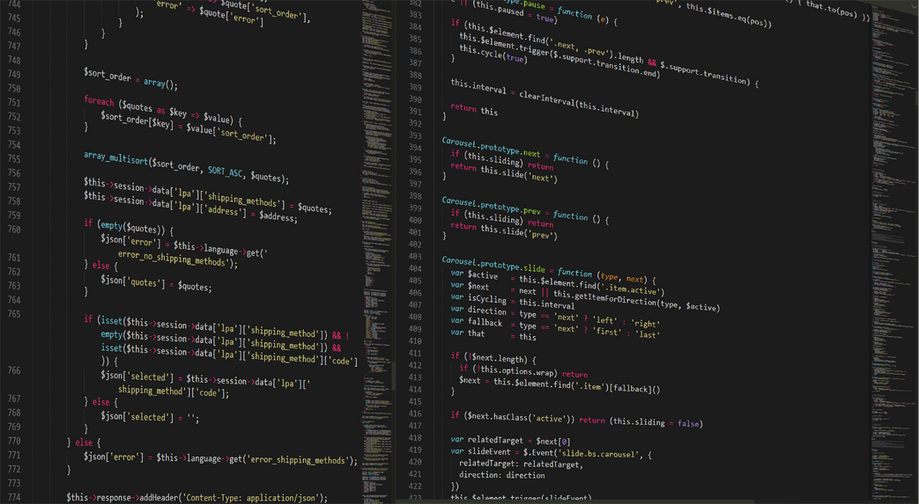
Programming Fundamentals
Overview
This course introduces students to fundamental programming concepts, focusing on logic, structured problem-solving, and coding using JavaScript. Through hands-on exercises, students will develop programming skills and explore essential techniques to design efficient and scalable solutions.
Key Skills & Knowledge Gained:
Writing structured JavaScript programs using variables, operators, loops, and functions
Debugging and testing code efficiently using built-in tools
Utilizing flowcharts and pseudocode to design problem-solving logic
Implementing decision-making and repetition structures in programming
Understanding the importance of structured programming for maintainability
Content Covered
JavaScript Programming & Logic Development
Variables & Operators: Assigning values and performing calculations
Decision Structures: IF/Else statements, nested conditions, and switch cases
Loops: For and While loops to optimize code execution
Debugging & Program Design
Pseudocode & Flowcharts: Designing algorithms before coding
Error Types: Understanding syntax, logic, and runtime errors
Testing & Debugging: Utilizing development tools for troubleshooting

Slide 15
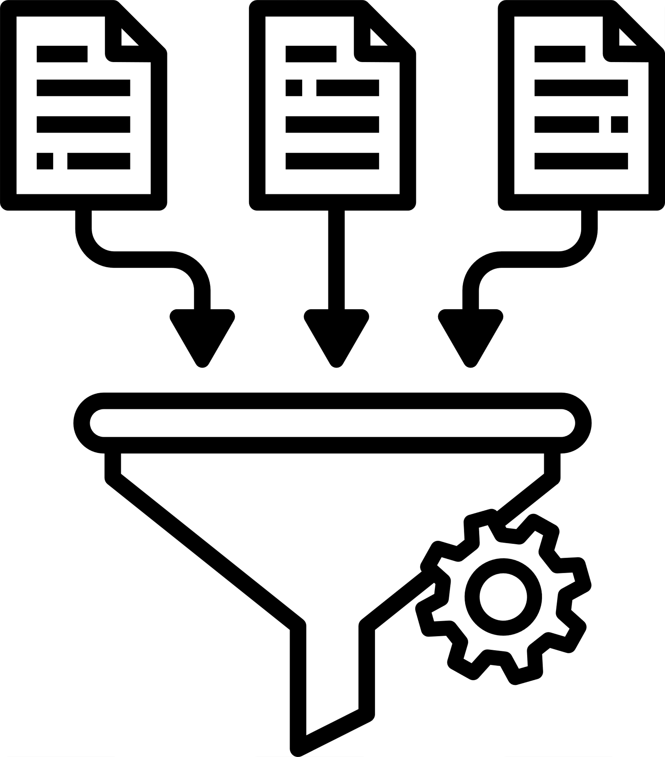
Database 2
Overview
This course expands on database concepts, covering advanced SQL queries, relational database design, and optimization techniques. Students will learn to structure and manage databases effectively while developing data models to ensure integrity and efficiency.
Key Skills & Knowledge Gained:
Writing complex SQL queries for multi-table data retrieval
Constructing databases using relational technology best practices
Developing ERDs to model and improve database relationships
Optimizing database performance through query tuning
Content Covered
SQL SELECT Statements
Multi-Table Joins: Inner and Outer joins for relational querying
Subqueries: Nesting queries to structure complex data retrieval
Computed Columns: Using SQL functions for calculated values
Database Design Concepts
Normalization: Applying structured design to optimize data integrity
Keys & Relationships: Understanding primary, foreign, and composite keys
Query Optimization: Enhancing retrieval speed and database performance
ERD (Entity-Relationship Diagram)
Purpose & Benefits: Visualizing database structures
Case Study: Developing an ERD for a retail business managing inventory and sales

Slide 16

BI Data 1
Overview
This course teaches students how to create professional-grade reports using Microsoft Power BI Report Builder and SQL Server. Students will learn how to connect databases, generate queries, and design paginated reports that effectively communicate business data.
Key Skills & Knowledge Gained:
Writing SQL queries to extract and filter data for reporting
Connecting databases via ODBC for seamless data integration
Designing professional reports with tables, charts, and summaries
Building dynamic dashboards using Power BI
Content Covered
SQL Querying for Reports
Data Retrieval: Using SELECT, WHERE, and JOIN statements
Aggregation & Formatting: Structuring reports with computed fields
SQL Filtering: Applying conditions for refined data selection
Report Design & Customization
Table & Chart Integration: Creating structured and visualized data outputs
Paginated Reports: Formatting multi-page structured reports for business analysis
Dashboard Development: Using Power BI features for dynamic visualization

Slide 17



Business Analytics
Overview
This course provides an in-depth understanding of business analytics, data-driven decision-making, and visualization techniques. Students will learn how to apply statistical and analytical tools to interpret business data for forecasting and strategy development.
Key Skills & Knowledge Gained:
Using spreadsheet tools for data analysis and reporting
Applying predictive and prescriptive analytics for informed decision-making
Designing dashboards and reports using data visualization techniques
Mining data for trends and business insights
Content Covered
Analytical Techniques & Business Decisions
Forecasting Models: Using analytics to predict business trends
Key Performance Indicators (KPIs): Identifying critical business metrics
Data Visualization & Dashboarding
PivotTables & Charts: Structuring and analyzing large datasets
Interactive Dashboards: Presenting data effectively for business decision-making

Slide 18




Programming
Fundamentals
BI Data 1
Database 2
Buisness Analytics

Slide 19
Semester Two Course Work
Project Management
This course explores the core principles of project management, including its benefits, professional roles, and organizational structures such as the Project Management Office (PMO). Students will develop team leadership skills, learning to manage stakeholders, influence decision-making, and resolve conflicts effectively. The course covers the project life cycle, proposal development, and key documentation like project charters and work breakdown structures (WBS). Practical applications include scope management, resource allocation, budgeting, risk mitigation, and earned value management techniques. The course concludes with post-mortem evaluation, ensuring continuous improvement in project execution.
Python
Data Programming Designed for aspiring programmers, this course introduces the fundamentals of Python development. Students will install development tools and write programs using variables, data types, decision-making constructs, loops, and functions. The course emphasizes working with structured data, utilizing lists, file input/output operations, and object-oriented programming with classes. Advanced topics include integrating Python with SQLite databases and leveraging data libraries such as Pandas for analytics. Hands-on exercises include coding projects, database queries, and generating interactive data reports using JupyterLab.
Introductory ETL
This course introduces the fundamentals of Extract, Transform, Load (ETL) processes, essential for data integration and management. Students explore techniques for integrating structured and unstructured data from multiple sources into a single destination for business intelligence analysis. Topics include securing, cleaning, transforming, and validating data, ensuring accuracy and consistency in ETL workflows. The course covers data usability assessment, transformation methods, and loading strategies, including data warehousing and cloud database solutions. Hands-on exercises involve developing ETL pipelines using industry-standard tools and testing methodologies.
BI Data 2
Interactive Designed for data professionals, this course focuses on advanced business intelligence techniques using Microsoft Power BI Desktop and Power BI Service. Students install SQL Server Developer, configure Power BI environments, and connect to multiple data sources, including databases and web services. Topics include transforming and cleaning data, applying filters, designing interactive reports, and building visualizations like charts, tables, and maps. Advanced features such as row-level security, DAX calculations, and report deployment are explored. The course also covers industry trends, Agile practices, and leveraging AI tools like ChatGPT for enhanced data analysis

Slide 20

Python
Overview
This course introduces students to fundamental programming concepts in Python, focusing on data manipulation, structured programming techniques, and database integration. Students will gain hands-on experience writing efficient Python code while working with data structures, functions, and file operations.
Key Skills & Knowledge Gained:
Writing Python programs using variables, operators, loops, and functions
Utilizing lists, file I/O operations, and object-oriented programming techniques
Integrating Python with SQLite databases for data storage and retrieval
Performing data analysis using Python libraries like Pandas
Developing interactive analytics reports with JupyterLab
Content Covered
Python Programming & Logic Development
Variables & Operators: Assigning values and performing calculations
Decision Structures: IF, ELSE, and nested conditions
Loops: FOR and WHILE loops for optimizing execution
Data Handling & File Operations
Reading, writing, and manipulating CSV files
Utilizing lists and functions for structured data management
Object-oriented programming with classes and methods
Data Integration & Analytics
Executing SQL queries within Python
Using Pandas for data transformation and analysis
Developing interactive reports with JupyterLab

Slide 21
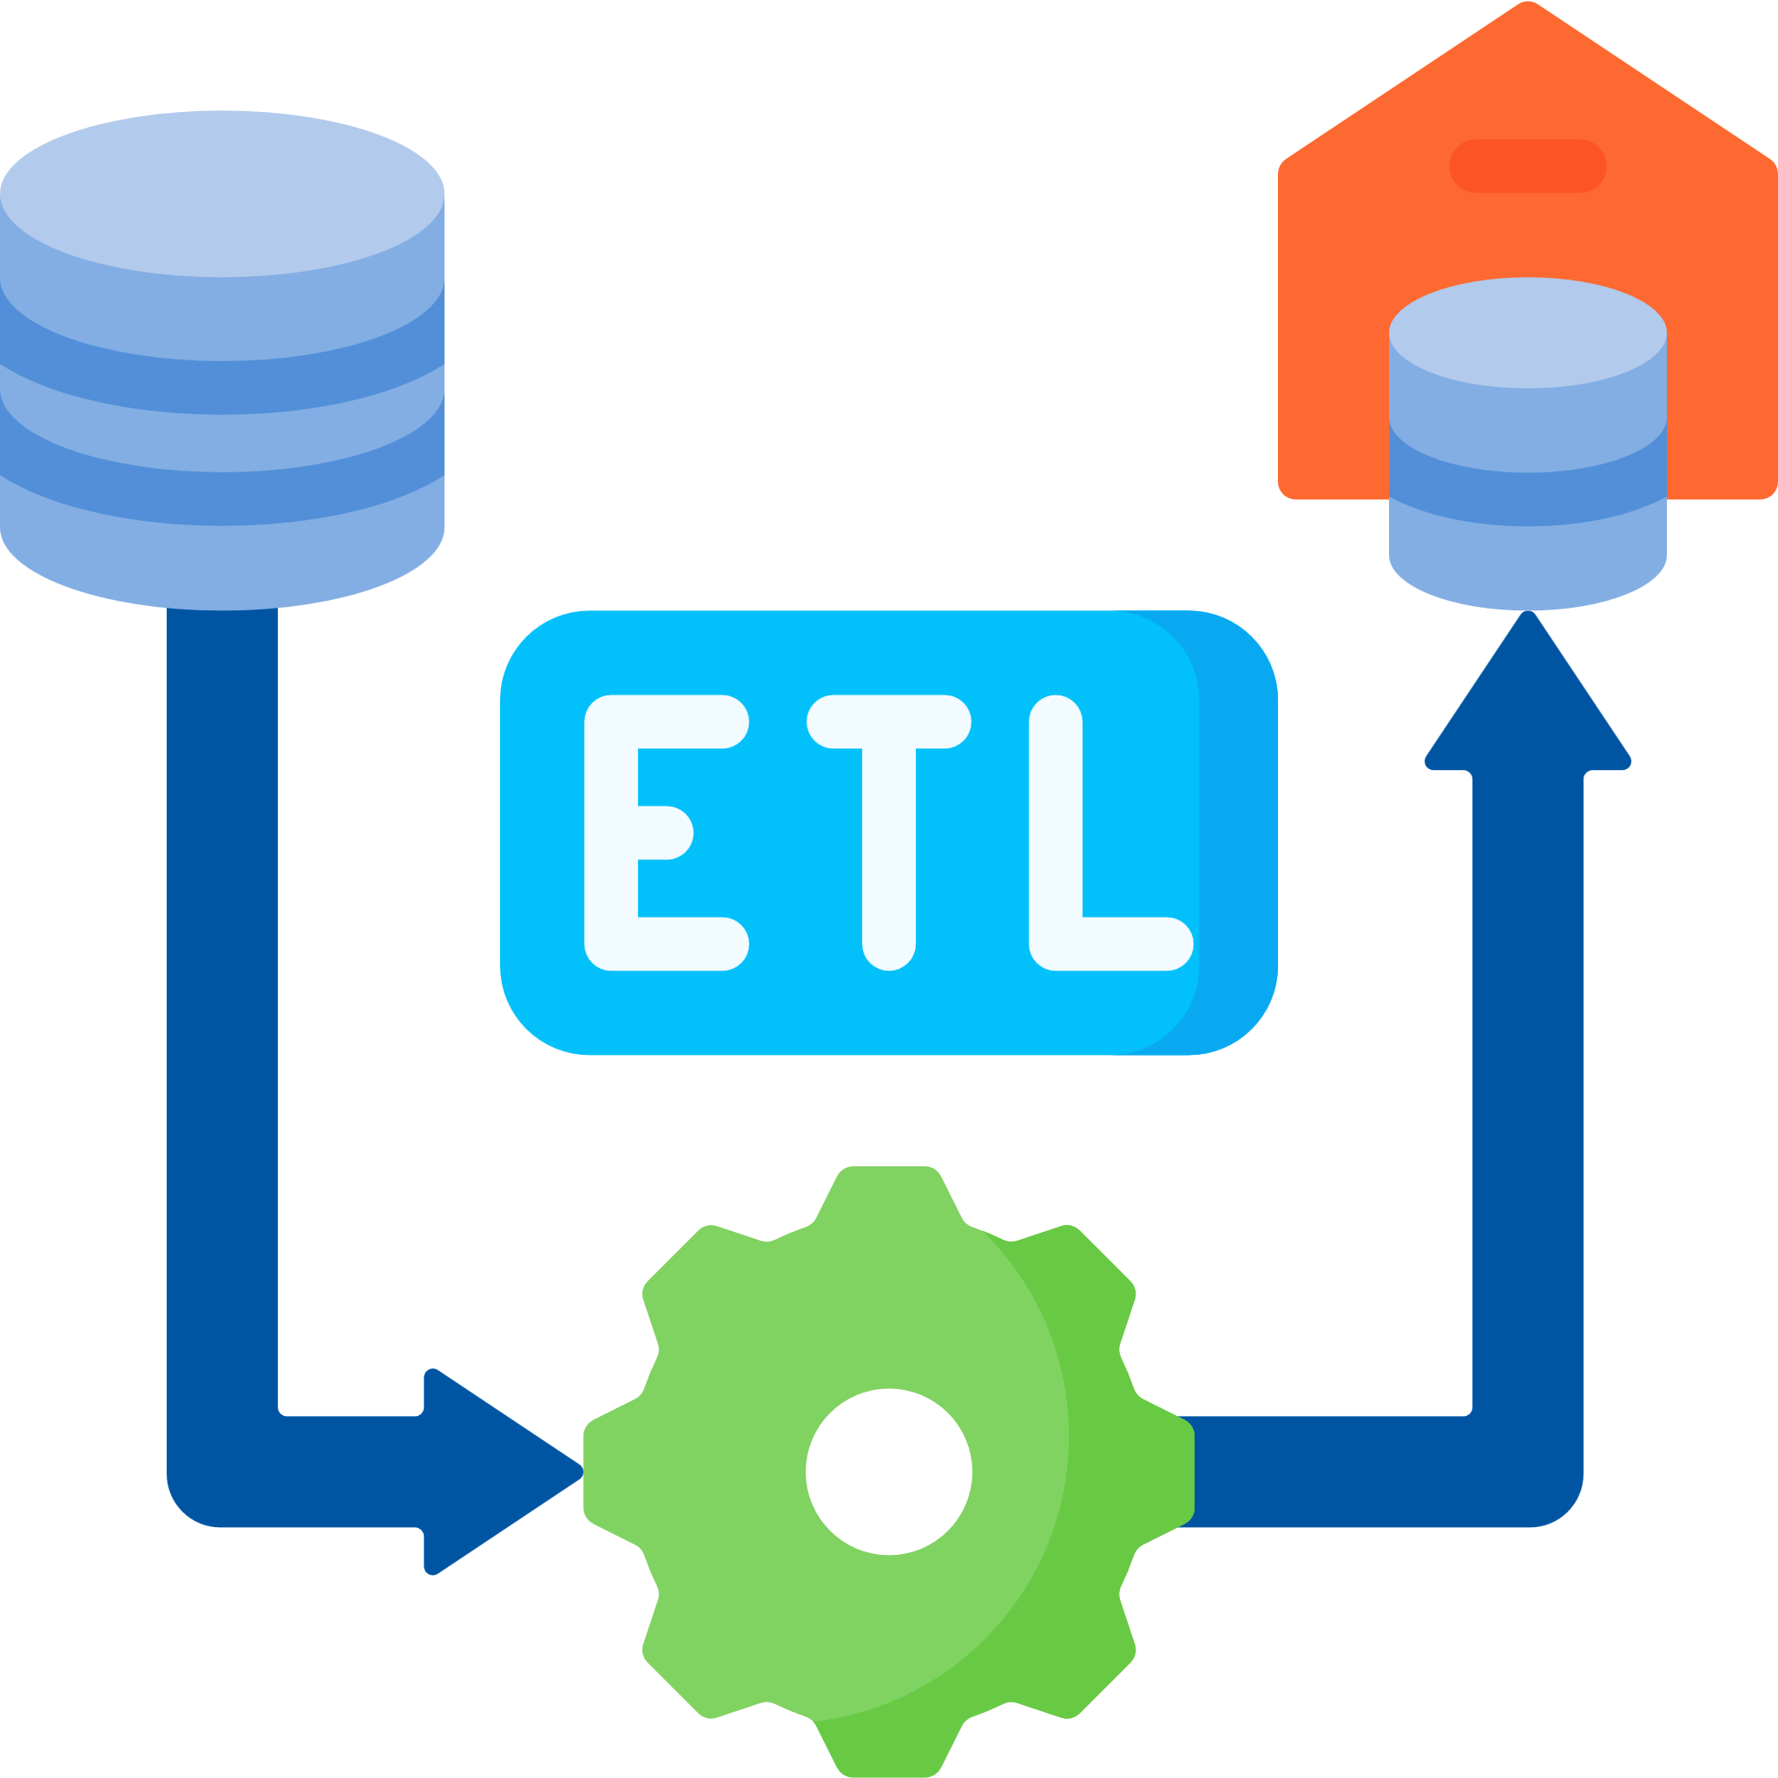
Introduction to ETL
Overview
This course provides a foundational understanding of Extract, Transform, Load (ETL) processes, essential for integrating and managing data from multiple sources. Students explore industry-standard tools and techniques to develop ETL pipelines, ensuring data accuracy and usability for business intelligence applications.
Key Skills & Knowledge Gained:
Defining ETL and explaining its importance in data integration
Extracting and transforming structured and unstructured data
Ensuring data security, quality, and consistency in ETL processes
Implementing validation techniques to assess data usability
Loading transformed data into databases and cloud destinations
Content Covered
Data Integration & ETL Basics
ETL Definition: Understanding core concepts
Data Sources: Structured vs. unstructured data extraction
Data Transformation: Cleaning, validation, and enhancement
ETL Pipeline Development
Identifying sources, transformations, and targets
Applying data quality practices for accuracy
Testing ETL workflows
Data Loading & Usability Assessment
Choosing appropriate loading methods
Implementing data validation techniques
Exploring data warehousing and cloud solutions

Slide 22

BI Data 2
Overview
This course explores advanced business intelligence techniques using Microsoft Power BI Desktop and Power BI Service. Students gain hands-on experience in data transformation, interactive report design, and security configurations for effective business reporting.
Key Skills & Knowledge Gained:
Installing and configuring SQL Server and Power BI tools
Connecting to multiple data sources, including databases and web services
Transforming data using Power Query for reporting accuracy
Designing interactive reports with visuals, slicers, and filters
Implementing row-level security and governance best practices
Content Covered
Power BI Setup & Data Integration
Installing Power BI Desktop & SQL Server tools
Connecting to databases, web sources, and spreadsheets
Filtering and sorting SQL queries
Data Transformation & Report Building
Cleaning and shaping data with Power Query
Designing dashboards using charts, tables, and maps
Implementing advanced visual features
Security & Deployment
Configuring row-level security and access controls
Deploying reports to Power BI Service
Monitoring and maintaining business intelligence reports

Slide 23

Project Management
Overview
This course provides a comprehensive introduction to project management principles, methodologies, and best practices. Students will explore the role of project managers, stakeholder engagement, and the full project life cycle. Through hands-on applications, students develop essential skills in scope management, team leadership, resource allocation, and risk mitigation for successful project execution.
Key Skills & Knowledge Gained:
Understanding project structures and management methodologies
Leading and managing project teams effectively
Communicating with stakeholders and managing expectations
Developing project proposals, charters, and work breakdown structures (WBS)
Managing risks, budgets, and scope while maintaining quality standards
Content Covered
Project Management Fundamentals
Defining project management and its role in business strategy
Exploring methodologies such as Agile and Waterfall
Understanding the Project Management Office (PMO)
Team Leadership & Stakeholder Communication
Building high-performing project teams
Handling negotiation and conflict management
Managing stakeholder expectations and engagement
Project Planning & Execution
Developing project proposals and charters
Creating work breakdown structures (WBS)
Managing project scope, resources, and budgeting
Risk & Post-Mortem Analysis
Identifying risks and preparing contingency plans
Monitoring project performance and earned value management
Conducting post-mortem evaluations and closing projects

Slide 24
Python
Introduction to ETL
Project
BI Data 2
Management

Slide 25
Semester One Course Work
Data Security and Privacy
Explored the significance of protecting sensitive data and maintaining privacy in digital environments. This course covered key concepts of data security, including encryption techniques, access control mechanisms, and compliance with regulations such as GDPR, CCPA, and HIPAA. Learned to classify and secure Personally Identifiable Information (PII), implement Microsoft SQL Server database security, and recognized social hacking attempts. Developed strategies to mitigate phishing attacks, manage network vulnerabilities, and respond effectively to security incidents and data breaches. Additionally, examined emerging trends such as privacy by design, AI-driven security, and employee security training to stay ahead in the evolving cybersecurity landscape.
Machine Learning
Gaied hands-on experience with machine learning algorithms, exploring supervised, unsupervised, and reinforcement learning techniques. This course covers the key steps in the ML process, emphasizing the importance of data in training models. Utilized Python and relevant libraries to develop predictive models and interpret results. Investigated the broader impact of Artificial Intelligence (AI), emerging trends in ML, and cutting-edge AI/ML tools. Through practical applications, refined skills in data analysis, model evaluation, and AI-driven decision-making.
BI Data 3
Advanced my expertise in Power BI, mastering fundamentals, navigation, and data visualization techniques. This course covered data modeling, transformation, and optimization, enabling me to create insightful reports and dashboards. Explored collaboration strategies and real-world applications, integrating business intelligence tools to drive data-driven decision-making.
Data Analytics Capstone
Applied my data analytics skills in a comprehensive capstone project, demonstrating proficiency in data querying, extraction, transformation, and loading (ETL). Developed reports and visuals to communicate insights effectively with stakeholders. Built a professional portfolio, prepared for data analytics employment, and engaged in the job search process. Emphasizing business professionalism in IT, this course ensures readiness for real-world analytics roles.

Slide 26

Data Security and Privacy
Overview
This course explores the principles of data security and privacy, focusing on protecting sensitive information, regulatory compliance, and secure data management. Students will gain hands-on experience with data classification, encryption techniques, SQL Server security, and network protection strategies while analyzing real-world security scenarios.
Key Skills & Knowledge Gained:
Defining and classifying sensitive data and Personally Identifiable Information (PII)
Understanding GDPR, CCPA, and HIPAA compliance requirements
Implementing SQL Server security measures, including access control and encryption
Recognizing social engineering and phishing attacks and developing prevention strategies
Managing network vulnerabilities, password security, and firewall configurations
Responding to security incidents and data breaches with structured response plans
Exploring emerging trends such as AI-driven security and privacy by design
Content Covered:
Key terminology and concepts in data security
Government regulations: GDPR, CCPA, HIPAA compliance principles
Techniques for securing PII and sensitive data
Database & Network Security
SQL Server security: Access control, permissions, encryption
Identifying network vulnerabilities and managing TCP/IP ports
Best practices for password management and authentication
Cyber Threats & Incident Response
Recognizing phishing and social engineering techniques
Developing strategies to mitigate cyber attacks
Steps for handling security breaches and incident response
Emerging Trends in Data Security
AI and machine learning applications in cybersecurity
Privacy by design and proactive security measures
Importance of employee security training

Slide 27

Machine Learning
Overview
This course introduces students to machine learning (ML) concepts, focusing on data-driven predictions, algorithm development, and AI applications. Students will gain hands-on experience with Python-based ML tools, exploring supervised, unsupervised, and reinforcement learning techniques while interpreting model results.
Key Skills & Knowledge Gained:
Understanding ML fundamentals and emerging trends in AI
Implementing supervised, unsupervised, and reinforcement learning models
Utilizing Python and ML libraries for algorithm development
Executing data preprocessing, feature engineering, and model evaluation
Interpreting prediction results and optimizing ML models
Content Covered:
Overview of AI and ML trends
Key steps in the ML process
Types of ML: Supervised, Unsupervised, Reinforcement Learning
Data Processing & Model Development
Importance of data in ML and preprocessing techniques
Implementing ML algorithms using Python
Utilizing cutting-edge AI/ML tools for model training
Model Evaluation & Interpretation
Interpreting prediction results
Optimizing ML models for accuracy
Investigating real-world AI applications

Slide 28

BI Data 3
Overview
Overview This course focuses on Power BI fundamentals, enabling students to develop data models, visualizations, and business intelligence reports. Students will gain practical experience in data transformation, dashboard creation, and optimization techniques for real-world applications.
Key Skills & Knowledge Gained:
Navigating Power BI and understanding its core functionalities
Developing data models and performing data transformations
Creating interactive visualizations for business insights
Optimizing BI reports for collaboration and efficiency
Applying real-world BI solutions in business contexts
Content Covered:
Navigating Power BI interface
Understanding data connections and transformations
Data Modeling & Visualization
Structuring data models for analysis
Creating interactive dashboards and reports
Optimization & Real-World Applications
Enhancing BI reports for collaboration
Applying business intelligence strategies in industry scenario

Slide 29


Data Analytics Capstone
Overview
This capstone course integrates data analytics skills into a comprehensive project, preparing students for real-world employment in the field. Students will apply data querying, transformation, visualization, and reporting techniques while building a professional portfolio and engaging in the job search process.
Key Skills & Knowledge Gained:
Analyzing and querying data for insights
Performing data extraction, transformation, and loading (ETL)
Creating reports and visualizations for stakeholder communication
Building a data analytics portfolio showcasing technical skills
Preparing for employment and engaging in the job search process
Demonstrating business professionalism in IT environments
Content Covered:
Extracting and transforming data for analysis
Executing SQL queries for data retrieval
Visualization & Reporting
Developing interactive reports and dashboards
Communicating data insights effectively
Professional Development & Employment Readiness
Building a data analytics portfolio
Preparing for job applications and interviews
Demonstrating business professionalism in IT roles

Slide 30
Data Security
and Privacy
BI Data 3
Machine
Data Analytics
Learning
Capstone

